Slide 1

Simultaneous Linear Differential Equations with Constant Coefficients
Here we discuss differential equations in which there is one independent variable and two or more dependent variables. Such equations are termed as simultaneous equations. Here we consider only a system of linear differential equations with constant coefficients. We shall discuss the solution of these equations in the same manner as we do in the case of simultaneous linear algebraic equations.
Example 1: Solve the simultaneous linear differential equations:
Solution: Given

Slide 2

(i.e.) (D + 7)x − y = 0 (1)
and (D + 5)y + 2x = 0 (2)
Now (2) + (D+5) (1), we have 2x + (D + 5)y = 0
(D + 5)(D + 7)x − (D + 5)y = 0
(D + 5)(D + 7)x + 2x = 0
That is (D²+12D+35+2)x = 0 ⇒ (D²+12D+37)x = 0 (3)
The auxiliary equation of (3) is m² + 12m + 37 = 0
The complete solution of (3) is
(4)

Slide 3


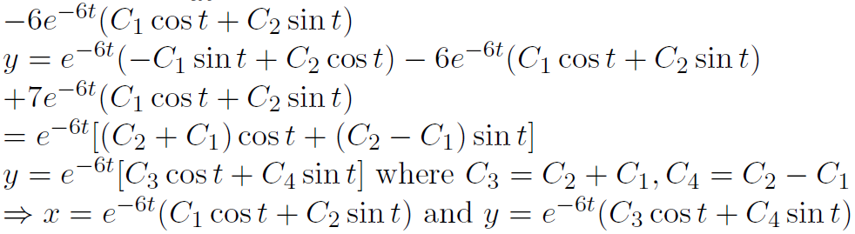

(5)
From equation (4),
Example 1: Solve:
Solution: Given

Slide 4

(i.e.) Dx + 2y = sin 2t (6)
and Dy − 2x = cos 2t (7)
(6) × D ⇒ D²x + 2Dy = 2 cos 2t
(7) × 2 ⇒ −4x + 2Dy = 2 cos 2t
D²x + 4x = 0
(i.e.) (D2 + 4)x = 0 (8)
The auxiliary equation of (8) is m² + 4 = 0
⇒ m² = −4 ⇒ m = 0 ± 2i = α ± iβ ⇒ α = 0, β = 2
⇒ C.F. = C1 cos 2t + C2 sin 2t
The complete solution of (8) is x = C1 cos 2t + C2 sin 2t
Now from (6), 2y = sin 2t − Dx
2y = sin 2t − (−2C₁ sin 2t − 2C₂ cos 2t)
= sin 2t + 2C₁ sin 2t − 2C₂ cos 2t
⇒ The solutions are

Slide 5
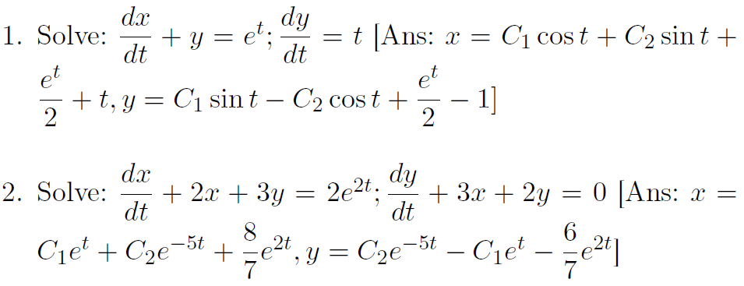
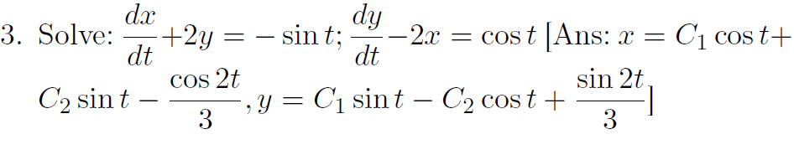
EXERCISE

